Slide 1
Writing Research Aims and Objectives
Mark Unwin
(adapted from various sources)

Slide 2

Formulating research aim and objectives
One of most important aspects of thesis
Research aim and objectives determine:
scope, depth and overall direction of research
Research Question is the central question of study
has to be answered on basis of research findings
Achievement of Research Aim provides the answer to the Research Question
Research aim specifies WHAT you hope to achieve
Research objectives are steps that address HOW you
will achieve your research aim

Slide 3
Aims and Objectives
Aims are statements of intent. They are usually written in broad terms. They set out what you hope to achieve at end of project Objectives, on the other hand, should ideally be specific statements that define measurable outcomes, e.g. what steps will be taken to achieve desired outcome
It is common to have ONE aim and SEVERAL objectives

Slide 4

Choice of vocabulary
Strong verbs - collect, extract, construct, classify, develop, devise, measure, produce, revise, select, synthesise
Weak verbs - appreciate, consider, enquire, learn, know, understand, be aware of, appreciate, listen, perceive

Slide 5
An example
Aim: To investigate the relationship between tectonic-plate movement and the gravitational effect of the alignment of the major planets. Objectives:
To extract data sets from the known historical record of tectonic-plate movement.
To extract data sets from astronomical tables, detailing the various alignments of the major planets covering the same period as data from the geological record.
To synthesise the data from both sets to establish if correlation points exist between major geological events and planetary alignments.

Slide 6

Typical errors
1. Choosing too broad a topic
eg research title: ‘An analysis of leadership practices’
Fails to answer the following questions:
A) Which aspects of leadership practices?
B) An analysis of leadership practices in which country?
C) An analysis of leadership practices in which company or industry?
Much better:
‘A study into the impacts of ethical behaviour
of a leader on the level of employee motivation
in the US healthcare sector.’

Slide 7
Typical errors (cont)
2. Setting an unrealistic aim.
You may wish to conduct a face-to-face interview with Bill Gates- You may have to settle with a regional manager of Microsoft instead!
3. Choosing research methods incompatible with the timeframe.
Using SMART Research objectives will enable your research.

Slide 8

SMART objectives
Specific – be precise about what you are going to do Measureable –you will know when you have reached your goal Achievable – Don’t attempt too much – a less ambitious but completed objective is better than an over-ambitious one that you cannot possible achieve. Realistic – do you have the necessary resources to achieve the objective – time, money, skills, etc. Time constrained – determine when each stage needs to be completed. Is there time in your schedule to allow for unexpected delays?

Slide 9
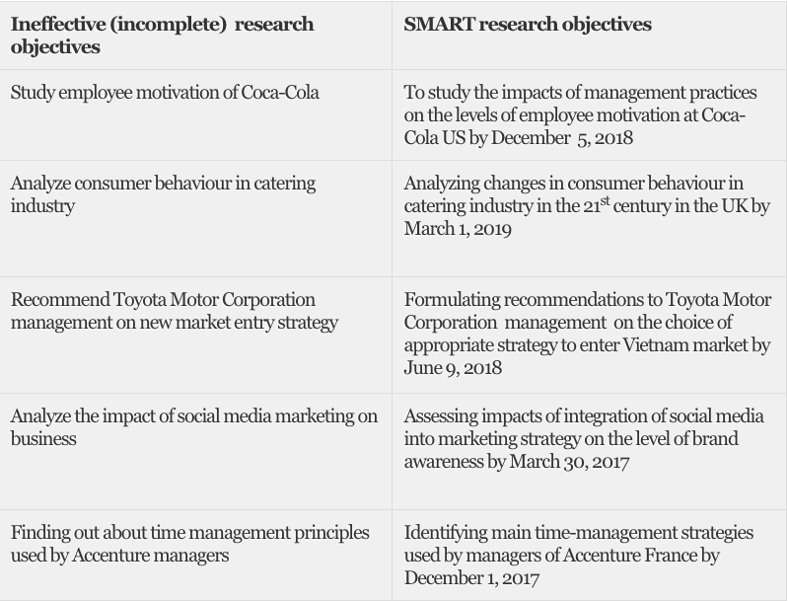

Slide 10
References
https://research-methodology.net/research-methodology/research-aims-and-objectives/
https://learn.solent.ac.uk/mod/book/view.php?id=116233&chapterid=15294

